Slide 1
How do political leanings, gender, and poverty status affect state HPV vaccination rates?

Slide 2
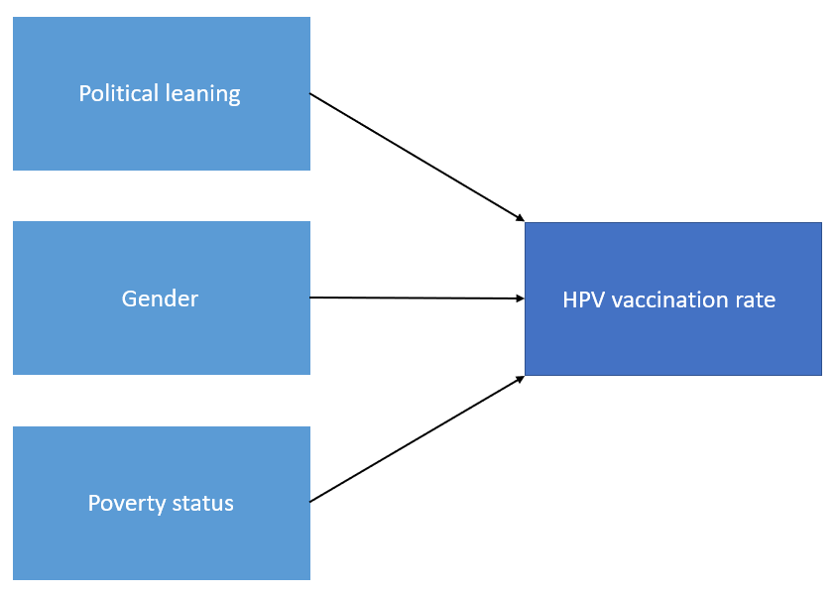
Background
Datasets:
CDC's 2018 Adolescent HPV Vaccination Coverage Report
2018 Political Leanings Gallup Poll

Slide 3
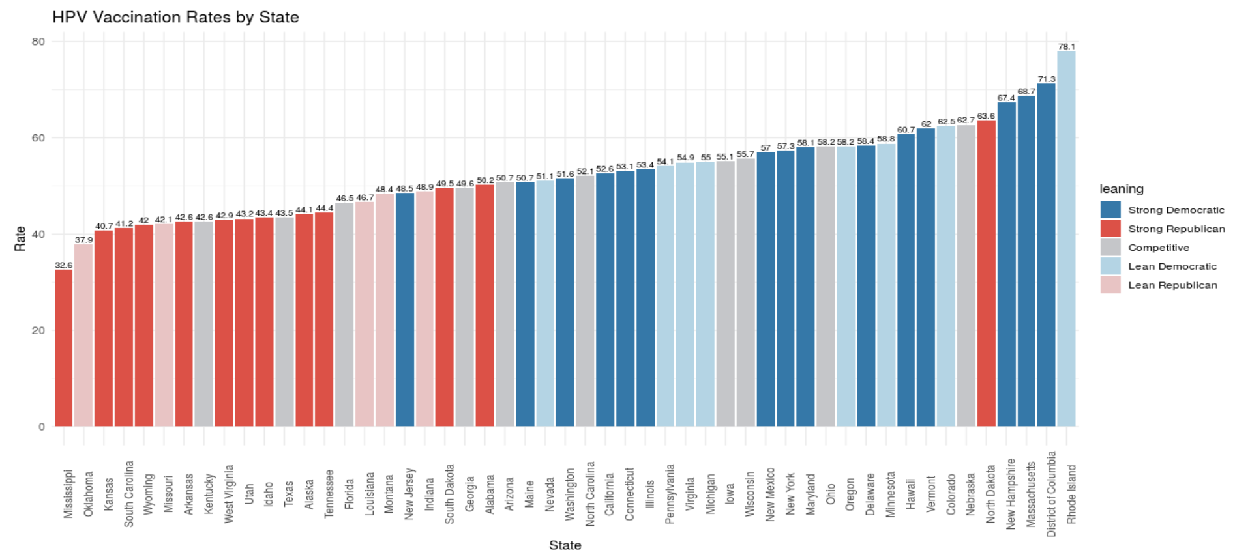

Slide 4
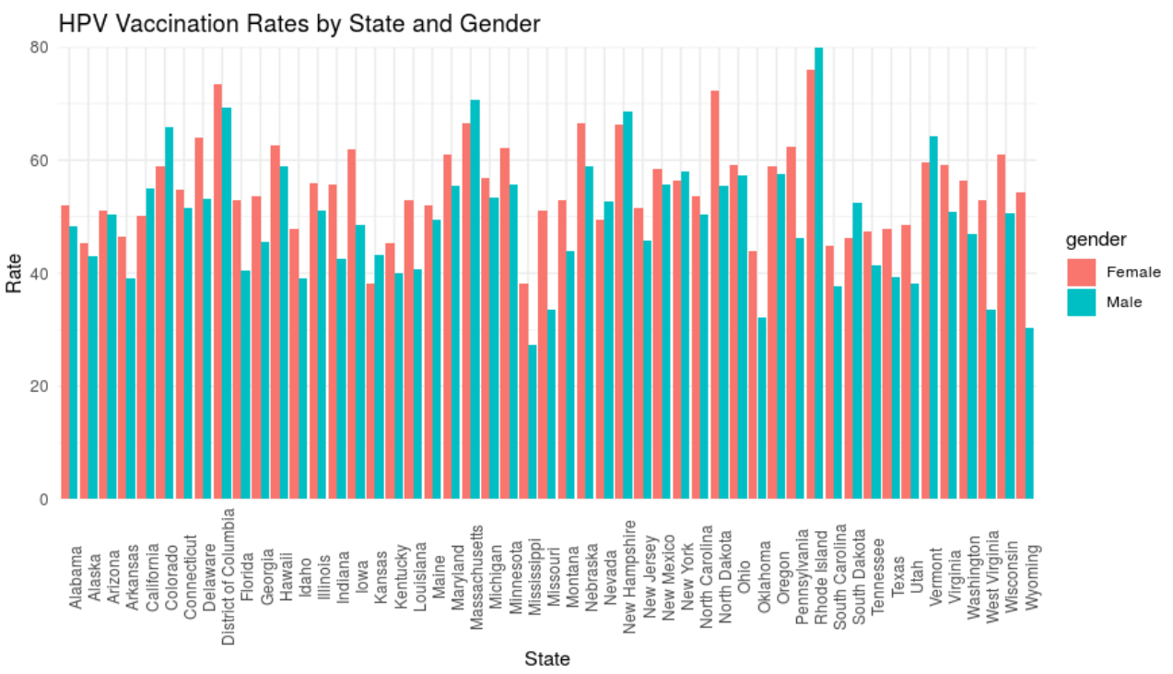
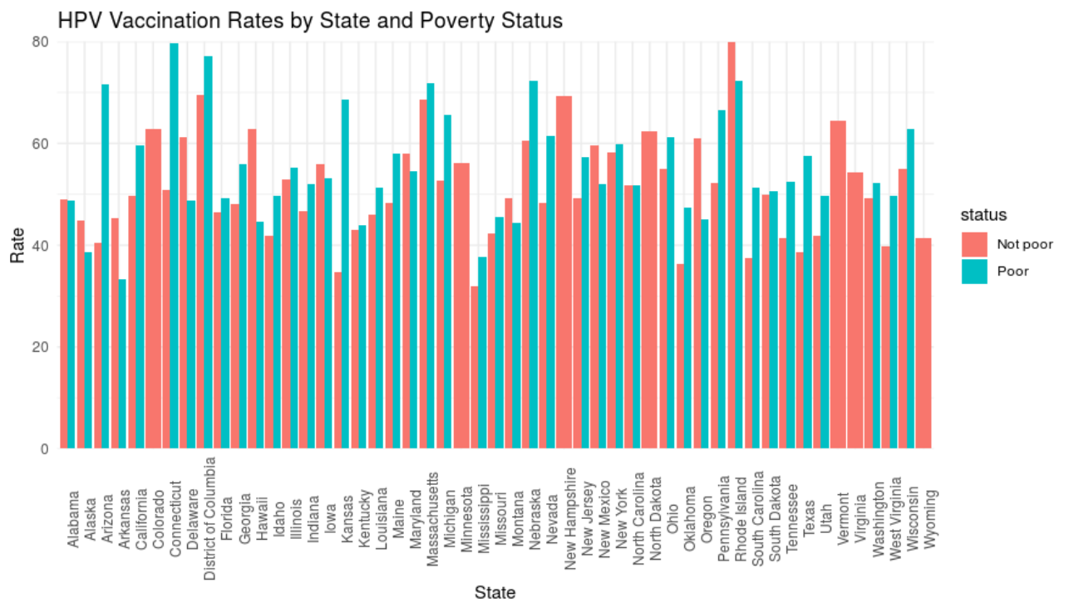
Analysis Plans
Count data → Poisson regression
Examine how HPV rates are affected by:
Gender
Poverty status (above or below poverty line)
Political leaning (democratic advantage)

